Slide 1
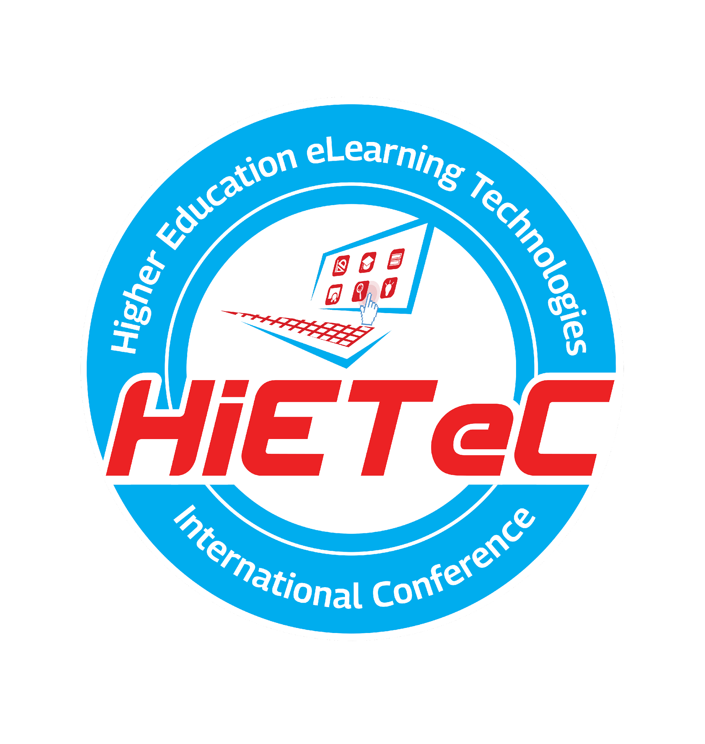


Higher Education eLearning Technologies International Conference

Slide 2
About
Dr. Marije Lesterhuis is Assistant Professor Educational and Training sciences at University Medical Center Utrecht (the Netherlands)
Department of Health professions education & Biomedical Sciences

Slide 3
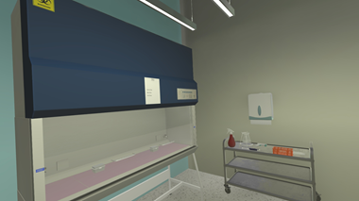
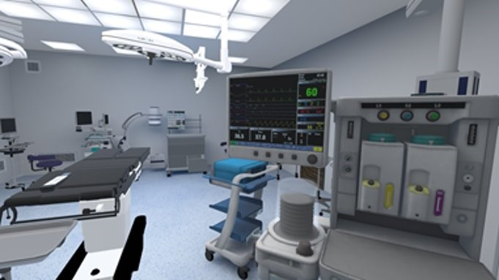
3 VR pilots
Working sterile in the lab
Biomedical sciences
Preparing the surgery room
Surgery assistants
Knowing effect of personal situation in taking medication
Medicine

Slide 4
Team Project
Teachers
Aiming for innovative, effective education
Technology support
Support all education involving technologies
Quality insurance
Monitoring
quality of education
Research
Notes:
Insert Team members if having team presentation

Slide 5
Evaluation is not Research
Evaluation = action oriented – determining the value of an intervention, to make recommendations for improvement
Research = driven by curiousity - advancing theoretical knowledge
(Cohen, 2007; Swanwick, 2020)

Slide 6
Not if it works, but why it works (not) for whom in which conditions
Focus on design principles/ mechanisms and link these outcomes
(Skivington, 2021)

Slide 7
The mechanisms
Context
  Aligment
  Curriculum
  Teacher
Learning
  Instruction
  Feedback
  Assessment
VR
  Presence and agency
  Motion sickness and working well

Slide 8
The outcomes
- Reaction
- Learning & Transfer
- Self efficacy

Slide 9
Methodology
 | Working sterile | SR Ready | Patient background
VR | Survey | Survey | Survey
Learning | Survey + observation | Focus group | Observation
Context/ embedding | Survey + observation | Survey + focusgroup | Observation
Outcomes | Test + survey | Survey | Qualitative test

Slide 10
Results
VR – average to high satisfaction – however difference depending on the learning goal and type of VR
Learning – different between pilots in design and in satisfaction
Context – all difficulties with alignment, all show the importance of teacher skills

Slide 11
Results
Self efficacy did not increase – caused by little assessment?
Learning & transfer tested/valued differently – caused by place in curriculum and alignment

Slide 12
Discussion
Because design mechanisms were not optimal yet, it wouldn’t have helped to evaluate the pilots on if it works

Slide 13
Conclusion
Scientific relevance is higher when focusing on mechanisms (what works for whom and when) – because these principles are easier to generalize to other context and new VR innovations.

Slide 14
Thanks!
Q&A
LI/ Researchgate:
Marije Lesterhuis
E: M.Lesterhuis@umcutrecht.nl

