Slide 1
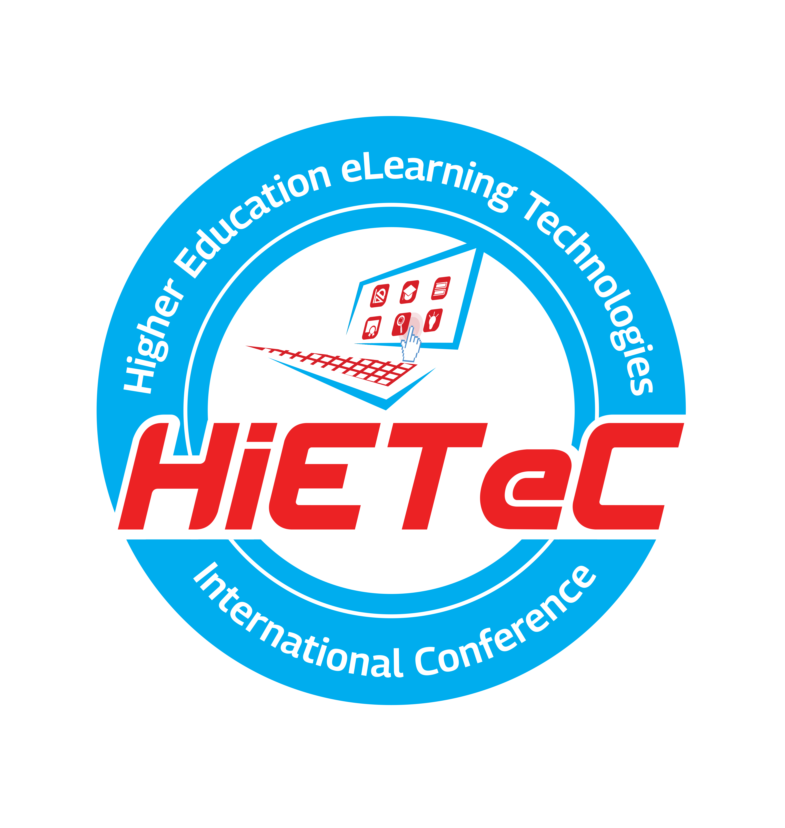


Higher Education eLearning Technologies International Conference

Slide 2
About
Geoffrey Ng’ang’a is the ICT Manager at Amref International University

Slide 3
Sub-Theme One
Paper Title: The Impact of Artificial Intelligence on Higher Education

Slide 4
Introduction
Artificial intelligence (AI) technologies like machine learning and natural language processing are rapidly advancing and poised to transform higher education.
Key innovations enabled by AI include:
  Personalized and adaptive learning platforms that offer individualized teaching and assessment
  AI assistants, chatbots and predictive analytics to optimize admission processes, graduation rates, and other administration
  Smart energy, security and facilities optimization through sensors, computer vision, and automation
  Accelerated research and knowledge discovery across disciplines through powerful neural network systems
As algorithms approach or exceed human capabilities in certain tasks, AI systems are taking on greater roles across campuses worldwide. However, AI also poses challenges around emerging ethical risks, workforce impacts, and the need to rethink higher education's purpose.
The integration of AI in higher education requires thoughtful policymaking to maximize benefits, mitigate adverse impacts, and ensure responsible governance. With proper strategy, AI can uplift higher education to new levels of inclusion, insight and efficiency.

Slide 5
Methodology
This presentation analyzes current applications and emerging challenges of AI in higher education through:
Literature review of existing research papers, reports, and case studies on AI in universities globally
Examination of real-world examples of AI implementations for teaching, administration, operations
Analysis of workforce forecasts, ethical issues, and policy options
Synthesis of findings on risks, opportunities, and recommendations regarding AI integration

Slide 6
Results
Key findings on the impacts of AI in higher education:
Over 50% of academic jobs are susceptible to automation from AI systems and intelligent courseware
Bias risks have emerged in some AI applications for student grading, resource allocation, campus policing
Developing creative thinking, leadership, and other uniquely human skills is vital as some cognitive tasks are automated

Slide 7
Discussion
AI can expand access, insight, personalization, and efficiency in higher education
Policies are needed for ethical AI development, bias prevention, and workforce transition programs

Slide 8
Conclusion
Responsible governance of AI in higher education will maximize benefits and opportunities while mitigating adverse impacts
With sound strategy, AI can propel higher education to new heights of inclusion, learning, and enrichment

Slide 9
Global AI Investment in Higher Education
Country (Year) Investment (USD Millions)
  USA (2021) 250
  China (2020) 150
  UK (2019) 80
  India (2021) 50
  Germany (2020) 30

Slide 10
Statistics
24/7 access to 13 virtual assistant chatbots increased productivity over 30% at the National University of Singapore
University of California, Berkeley's on-time graduation rates improved by 10-15% using AI predictive analytics and early intervention

Slide 11
Timeline
First machine learning algorithms
Machine learning explodes with big data and GPUs
UC Berkeley implements AI for graduation tracking
Over 50% of research uses AI augmentation
Universities focus more on creativity over content
1920s
1950s
2010s
2016
2019
2022
2025
2027
2030
Artificial neural networks conceived
AI tutors emerge in higher education
Central Michigan University’s AI teaching assistant improves scores 20%
Machine learning degrees common

Slide 12

Thanks!
Q&A

